Slide 1

U of U GPS stack
Chris Chadwick
Eric Hsu
Michael Stevens
Rashin Bolkameh
Dan Rolfe
Dr. Cameron Charles

Slide 2
Outline
Introduction
Overview
How we will get it done
Risks
Milestones

Slide 3
Introduction
The Global Positioning System (GPS) is a fully functional Global Navigation Satellite System (GNSS).
The goal of this project is to place a chip with a GPS receiver, to calculate position, on the Sandia NESDAC stack.

Slide 4
Overview
We will be building a low power GPS stack for the NESDAC that is able to capture short sample of the GPS satellite signal and store these data into 1 to 2GB flash memory.
Process GPS samples on PC to acquire GPS coordinates.

Slide 5
Design Requirements
Must run off two CR2 batteries.
Must be able to stay on location for weeks.
Must interconnect with the current stack.

Slide 6
Design Decisions
Use a low power MSP micro controllers from TI.
Limited power consumption, 1 or 2 GB of flash memory for storage.
Communication for process on a computer, a mini-B USB port will be utilized.
Accelerometer will be incorporated for motion sensitive power management.
Either a SiGe or Rakon GPS front end receiver module.
A small, slim GPS antenna.

Slide 7
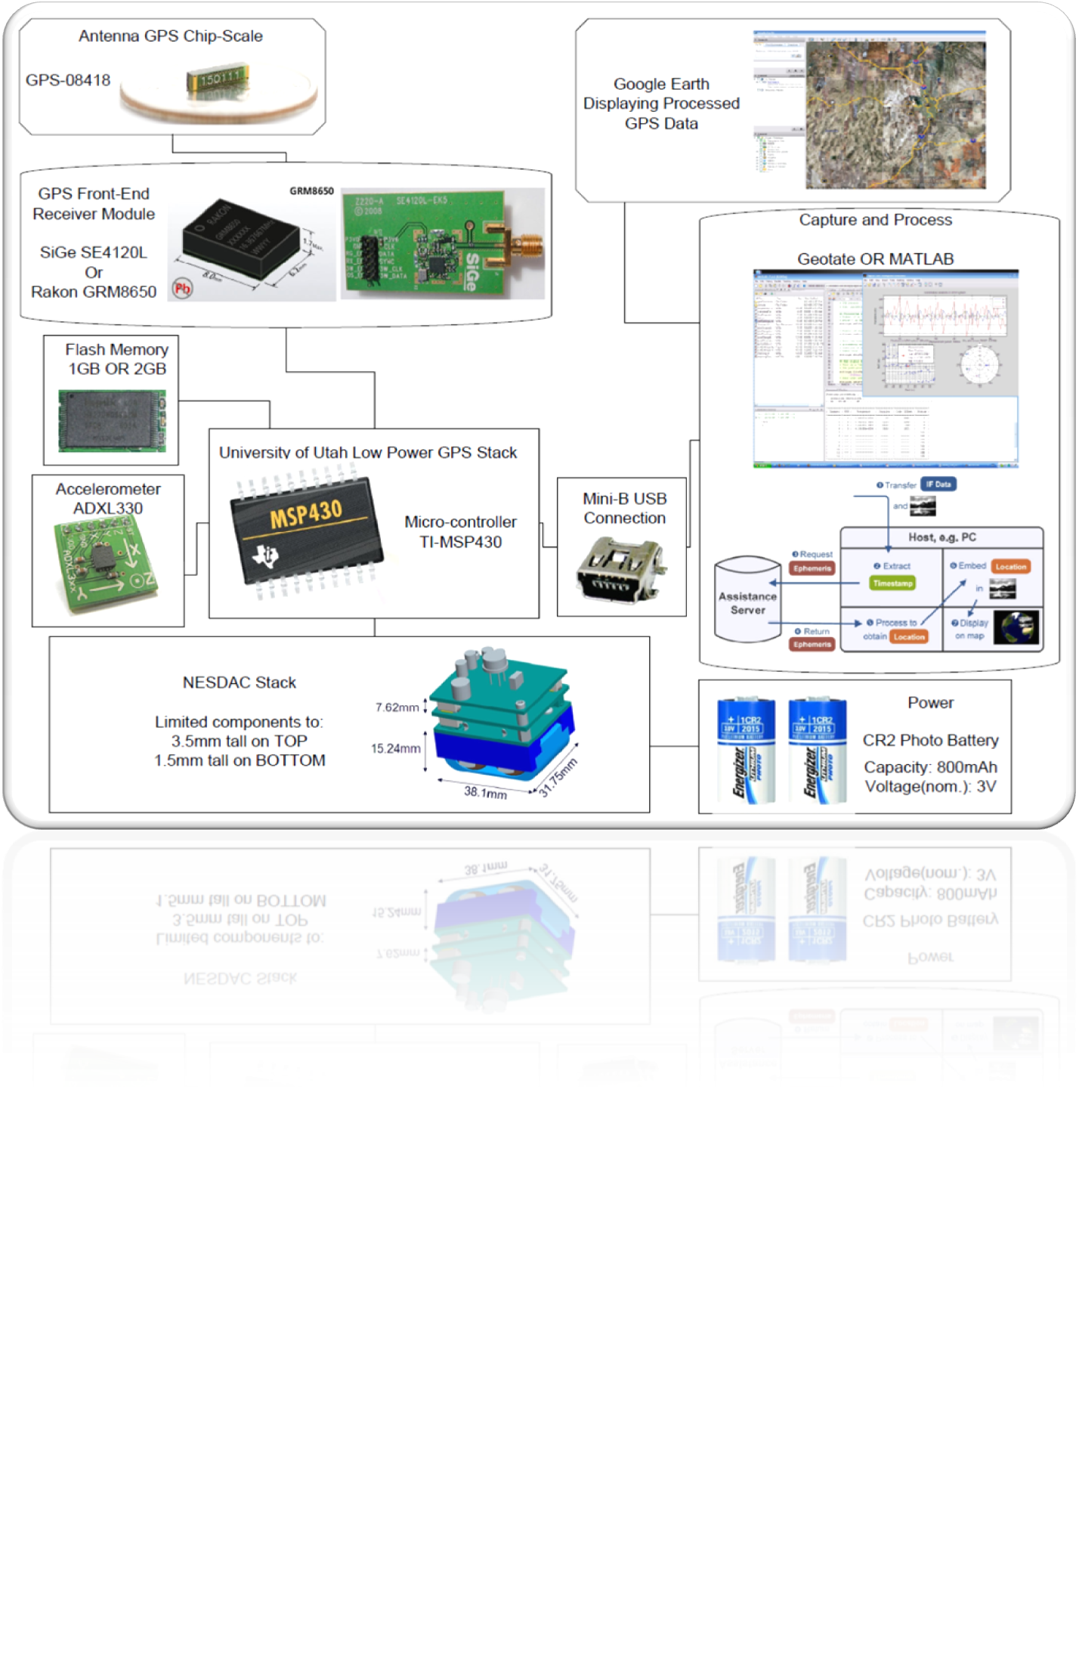

Slide 8
GPS Front End Module
For our applications minimum size is an important requirement.
No baseband processor in our selected GPS module the radio can be made very small.
Rakon GRM8650
SiGe SE4120L GNSS
GPS front-end functionality in a small package: GPS radio receiver, filtering, and oscillator TCXO.

Slide 9
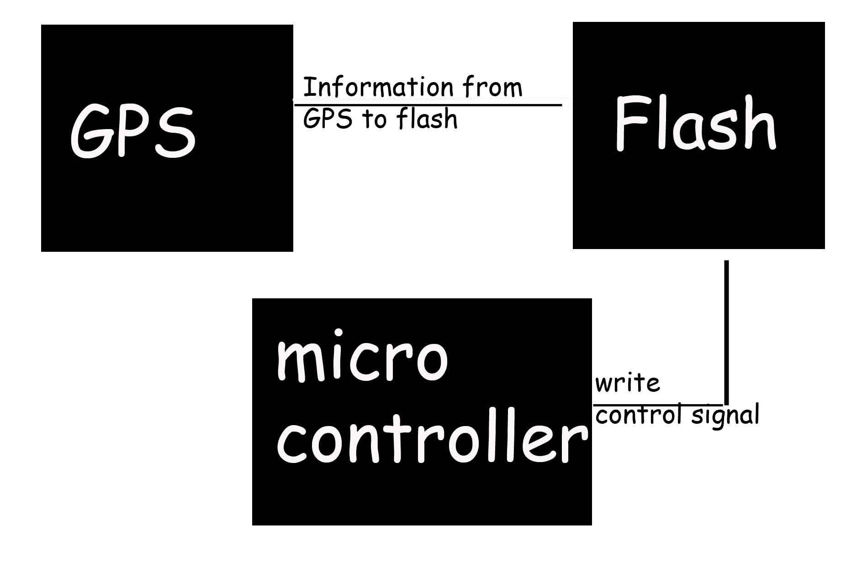
Memory Interface

Slide 10
Risks
Planning to use the Geotate software over the MatLab program
Still keeping the Matlab Program as our backup
When will the Geotate software be released?
Does the software work with the SiGe chip?
Can one of the Rakon chip be used, if needed?

Slide 11
Milestones
Task | Date (Tentative)
Board design | Dec 15
Programming of uController | Jan 12
Testing | Feb 28
Project Complete | March 6
Report | March 24

Slide 12
Question
Any questions?

